Slide 1


Slide 2

TITLE “DEFECT DETECTION IN MANUFACTURING QUALITY CONTROL”

Slide 3
SUMMARY
This project automates quality inspection in manufacturing using a Convolutional Neural Network (CNN). By training the model on images of both defective and non-defective parts, the system can accurately classify new parts as "OK" or "Defective." This solution enhances accuracy and efficiency, reducing the chances of defects being missed by human inspectors.

Slide 4
Problem Statement:
Manual inspection of parts in manufacturing is prone to human error, leading to missed defects and costly quality issues. This project aims to develop a Convolutional Neural Network (CNN) to automate defect detection, improving accuracy and efficiency in the inspection process.

Slide 5
Strengths: Reduces reliance on human inspectors, minimizing errors in defect detection. Weaknesses: Requires a large, diverse, and well-labeled image dataset to achieve high accuracy. Opportunities: As automation in manufacturing increases, this technology could become a standard in quality control. Threats: CNN performance might be affected by variations in lighting, camera angles, or image quality.

Slide 6
GOALS Achieve High Accuracy: Develop and train the Convolutional Neural Network (CNN) to accurately classify images of parts as either "OK" or "Defective" with high precision and recall. Seamless Integration: Integrate the trained CNN model into a quality inspection system that can operate in real-time within a manufacturing environment, ensuring smooth and efficient detection of defects. Scalability and Adaptability: Ensure that the system can be scaled to handle different types of parts and adaptable to various manufacturing processes or changes in part design.

Slide 7
Process Plow Diagram
Data Collection
Defect Classification
Data Preprocessing
Continuous Learning
Model Design (CNN)
Training the CNN
Model Evaluation:
Deployment

Slide 8
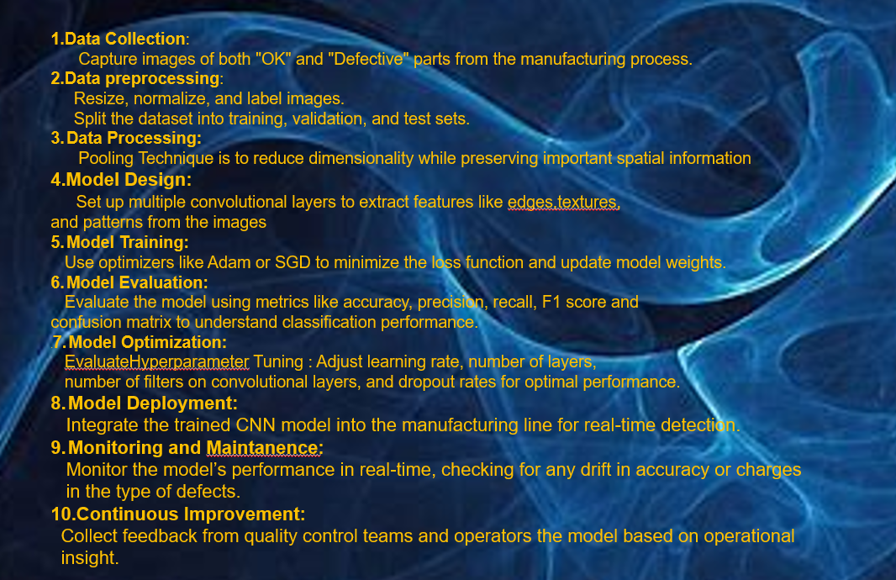

Slide 9
THANK YOU…

